Slide 1
Detecting local clusters with Kulldorf’s scan statistic

Slide 2
Spatial scan statistics
Scan statistics – based on comparisons of local rate estimates
Does the ratio of cases to controls (or cases per population at risk) appear “significantly” elevated in certain areas
Similar to the comparison of intensity functions
Goal is to detect specific clusters where the observed rate (or ratio) is inconsistent with the rate (or ratio) over the rest of the study area.

Slide 3
Kulldorff’s spatial scan statistic
This test detects spatial clusters based on a significant excess of cases within a moving cylindrical (or elliptical) window that systematically visits all spatial locations. Can be used for discrete (non-random and fixed locations) and continuous scan statistics (locations are random).
Creates an infinite number of circles of varying sizes around each point, maximum size = fixed proportion of pop.
Significance estimated using Monte Carlo methods – moving values around points randomly to estimate probaiblity that observed pattern occurred by chance.
Notes:
Sample of overlapping circles of different sizes created and used by SaTScan

Slide 4
Different outcome data
Different types of probabilistic models for discrete scan statistics according to the underlying distribution of the population at risk.
Poisson: number of events in a geographical location is Poisson-distributed, according to a known underlying population at risk
Bernoulli: 0/1 event data such as cases and controls
Ordinal: Ordered categorical data such as severity of disease
Exponential: Survival time data
Normal: Other types of continuous data

Slide 5
H₁ : there is an elevated risk within the window as compared to outside, for each location and size.
H₀: The risk of an event is the same within and outside the window

Slide 6
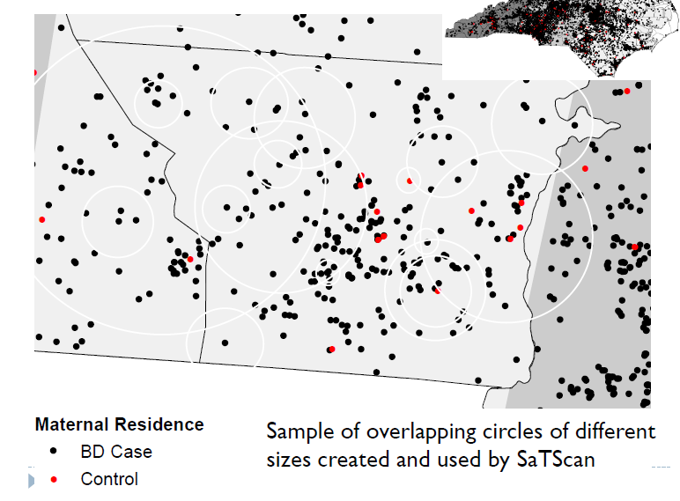
Using case-control data
Uses Bernoulli model (identical to binomial with single trial) to compare risk of being a case inside to outside the window.
Control
Malaria case
Notes:
This test uses a circular window that moves systematically throughout the geographic space to identify significant clustering of cases. The window is centred on each of a number of possible locations throughout the study area and at each location, the window size varies from zero to a pre defined upper limit (often 50% of the study population, which allows both small and large clusters to be detected, while ignoring clusters that contain more than 50% of the population). For each location and size of the scanning window, a likelihood ratio test is conducted to test the hypothesis that there is an elevated rate of disease as compared with the distribution outside. The window size and location with the maximum likelihood is defined as the “most likely” cluster (i.e. least likely to have occurred by chance). The distribution and p-value of the most likely and secondary clusters are determined by conducting Monte Carlo replications of the data set.

Slide 7
Using case-control data
Uses Bernoulli model (identical to binomial with single trial) to compare risk of being a case inside to outside the window.
6/36 = 0.16
11/232 = 0.05
Control
Malaria case
Notes:
This test uses a circular window that moves systematically throughout the geographic space to identify significant clustering of cases. The window is centred on each of a number of possible locations throughout the study area and at each location, the window size varies from zero to a pre defined upper limit (often 50% of the study population, which allows both small and large clusters to be detected, while ignoring clusters that contain more than 50% of the population). For each location and size of the scanning window, a likelihood ratio test is conducted to test the hypothesis that there is an elevated rate of disease as compared with the distribution outside. The window size and location with the maximum likelihood is defined as the “most likely” cluster (i.e. least likely to have occurred by chance). The distribution and p-value of the most likely and secondary clusters are determined by conducting Monte Carlo replications of the data set.

Slide 8
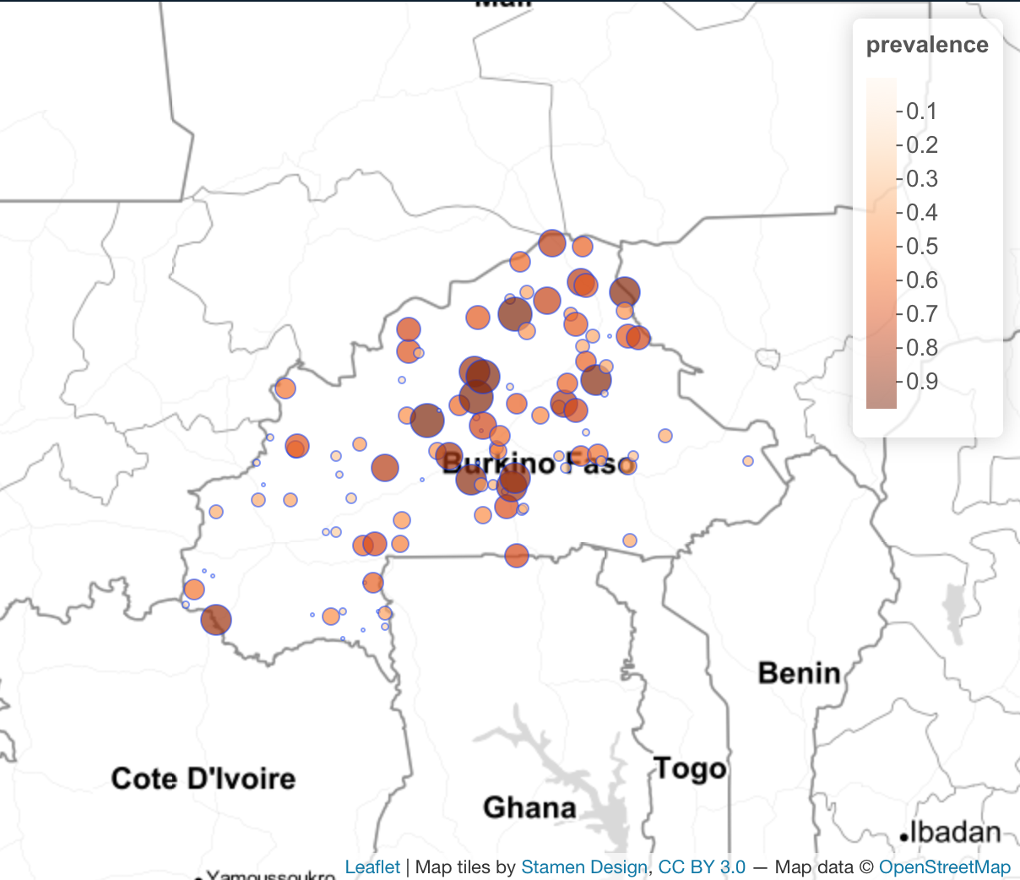
Using point prevalence data
Similar to the case-control scenario, but uses binomial model instead of Bernoulli, as our data are numbers positive and numbers examined (i.e. Binomial).
Probability of being a positive inside versus outside the window

Slide 9
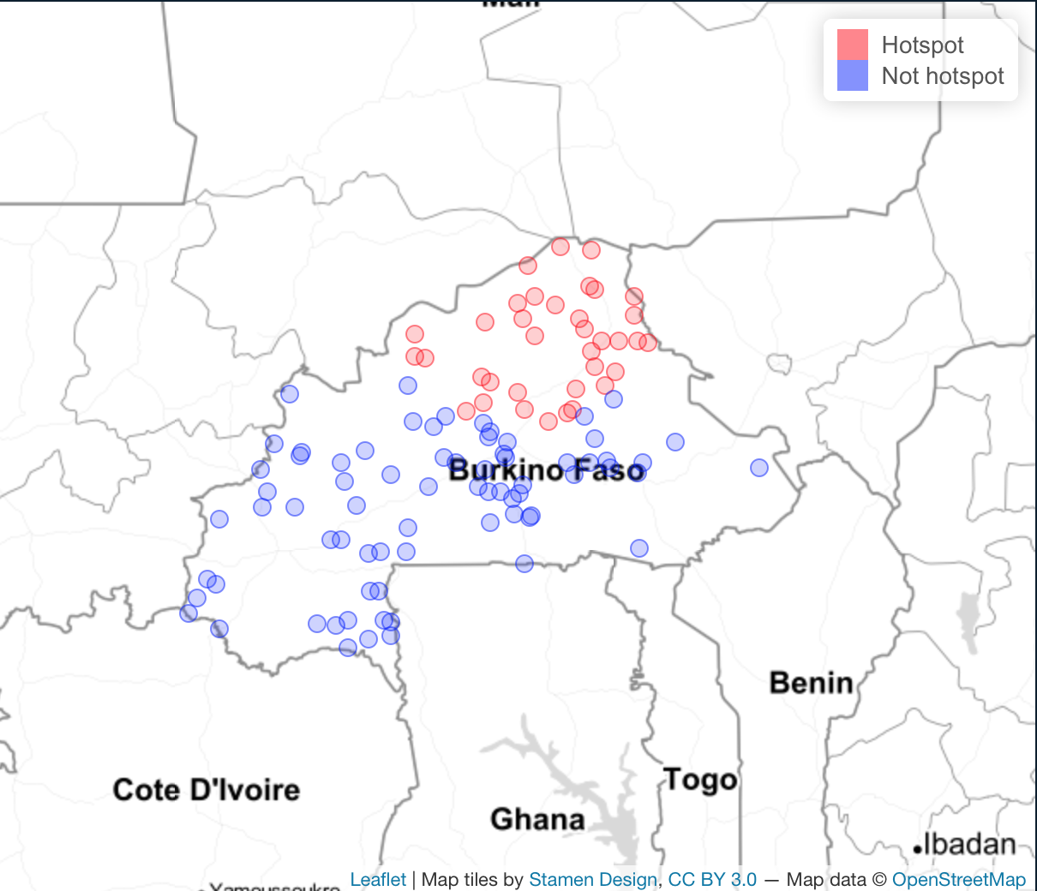
Using point prevalence data

Slide 10
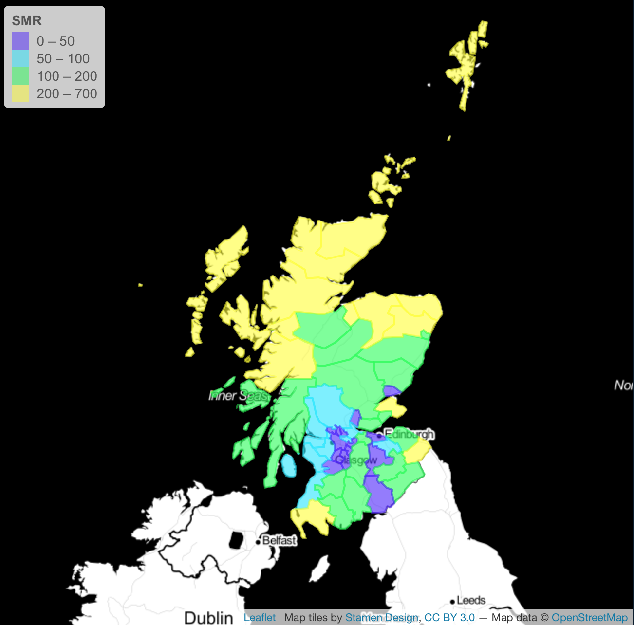
Using areal data
County-level (n=56) data for lip cancer among males in Scotland between 1975-1980.

Slide 11
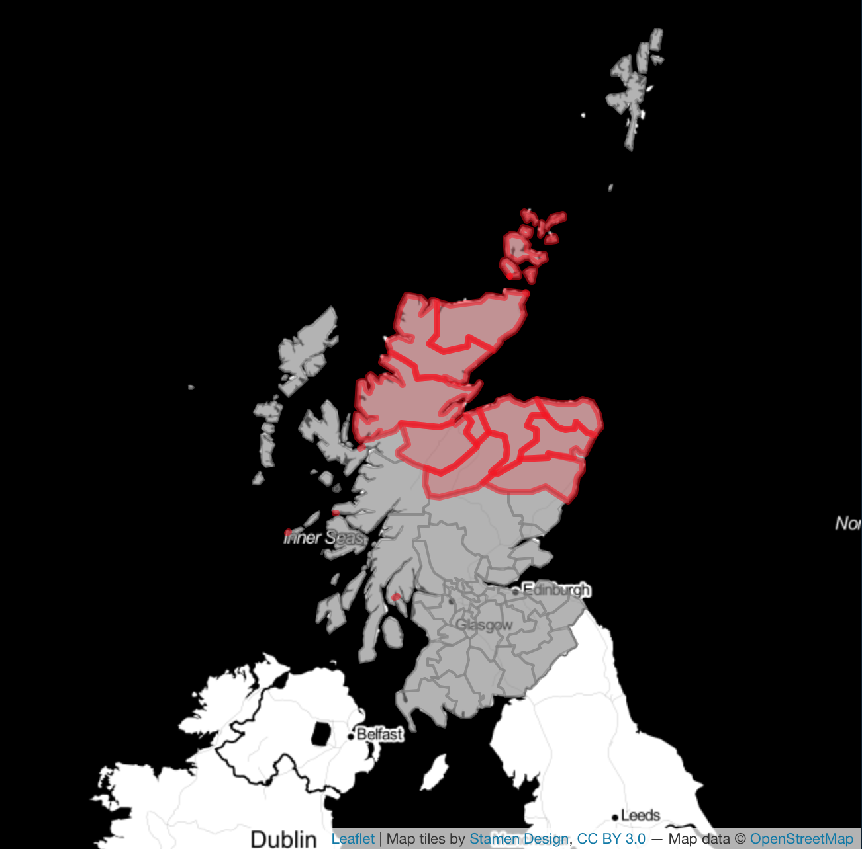
Using areal data
County-level (n=56) data for lip cancer among males in Scotland between 1975-1980.
Cluster analysis done using Poisson model: where the number of events in an area is Poisson distributed under the null hypothesis. Number of cases is compared to the background population data and the expected number of cases is proportional to the size of the population at risk in each circle.
Uses centroids of each areal unit

